Slide 1
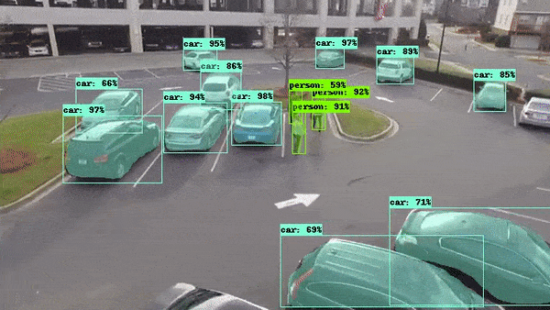
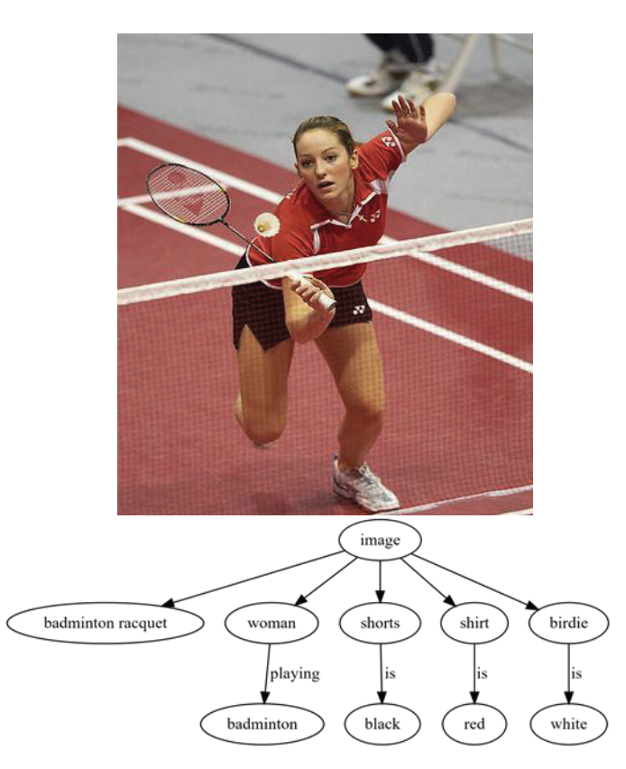
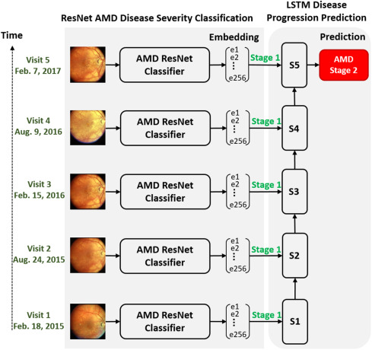
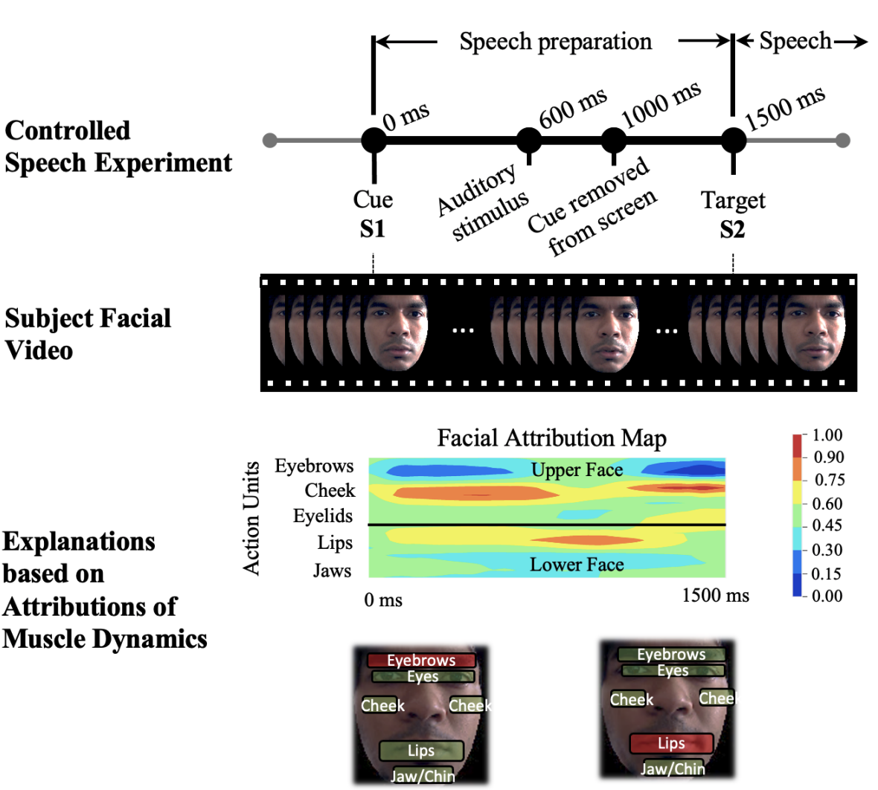
Deep Learning for Computer Vision
Sahba, Amin, et al. "Image graph production by dense captioning." 2018 World Automation Congress (WAC). IEEE, 2018.
Das, Arun, et al. "Interpretable Self-Supervised Facial Micro-Expression Learning to Predict Cognitive State and Neurological Disorders." Proceedings of the AAAI Conference on AI. Vol. 35. No. 1. 2021.
Das, Arun, et al. "Distributed machine learning cloud teleophthalmology IoT for predicting AMD disease progression." Future Generation Computer Systems 93 (2019): 486-498.

Slide 2
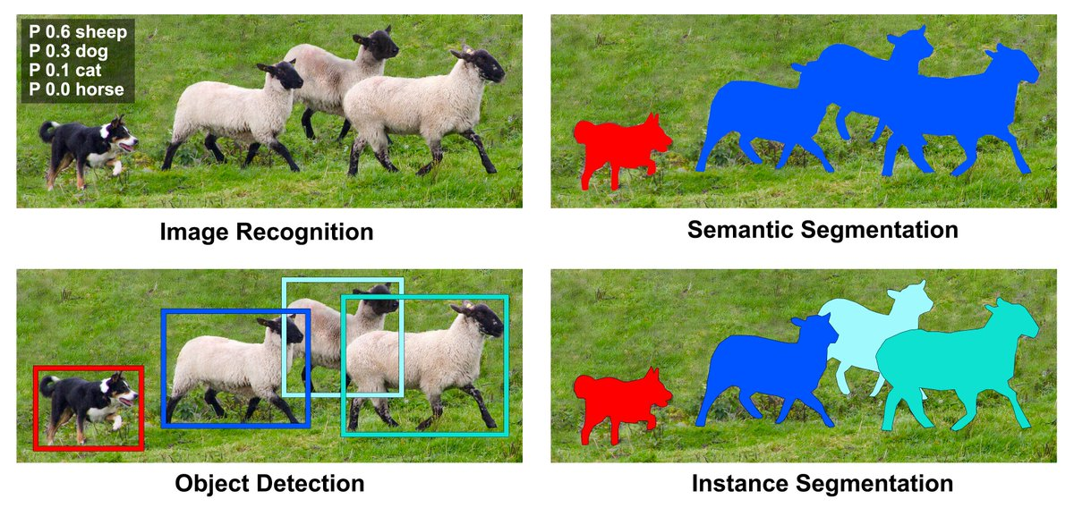
Major Applications of DL for Computer Vision
Christoph Reike, Deep Learning for Instance Segmentation of Agricultural Fields, Master thesis, 2017.

Slide 3
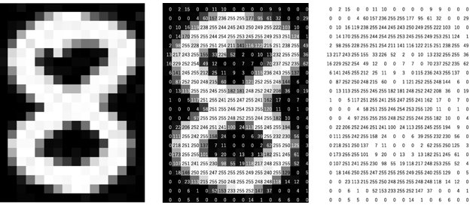
The AI needs to see!
Human vision is a complex phenomena starting with the light rays entering through cornea of the eye and the visual cortex making sense of the various signals it receives.
However, computers speak only numbers. Hence, images are represented as numbers, usually in intensities ranging from 0 to 255.

Slide 4
0 1 2 3 4 5 6 7 8 9 … column indices.

Slide 5
Hierarchical Mammalian Vision
During the 1960s, neurophysiologists David Hubel and Torsten Wiesel conducted a series of experiments to investigate the properties of the visual cortices of animals. In one of the most notable experiments, they measured the electrical responses from a cat’s brain while stimulating it with simple patterns on a television screen. What they found was that neurons in the early visual cortex are organized in a hierarchical fashion, where the first cells connected to the cat’s retinas are responsible for detecting simple patterns like edges and bars, followed by later layers responding to more complex patterns by combining the earlier neuronal activities.
Reference: https://ml4a.github.io/ml4a/convnets/

Slide 6
Define Such Features and use ML to solve?
What if we, as humans, define edges and shapes that define an object?
Can ML algorithms use these features faithfully and accurately predict the result we want?

Slide 7
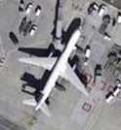
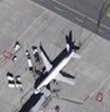
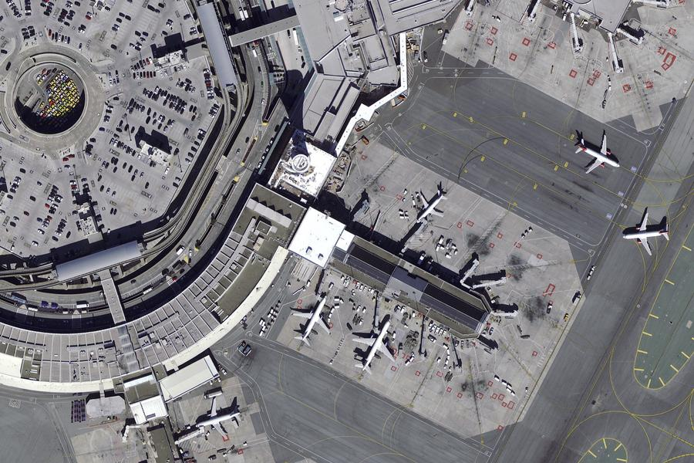
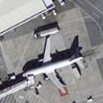

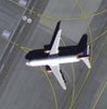
Shortcomings with Traditional Hand Feature Engineering for Computer Vision
Orientation
Lighting
Scale
Background
…

Slide 8
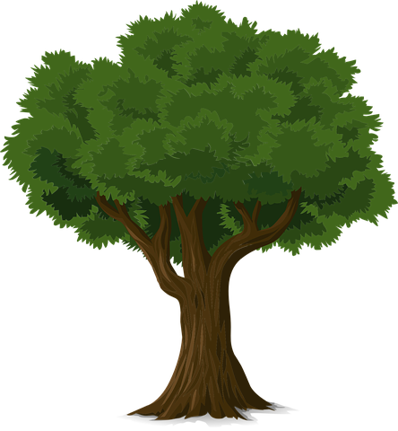
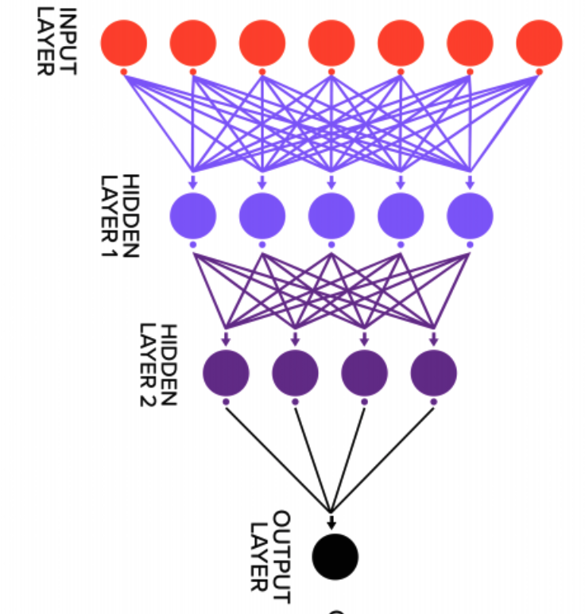
Use Fully Connected Networks to Learn?
Input Image
Primitive Features
Object Parts
Object
Oriented Edges
HIERARCHICAL
FCN
Bark, leaves, etc.
Tree
Tree

Slide 9
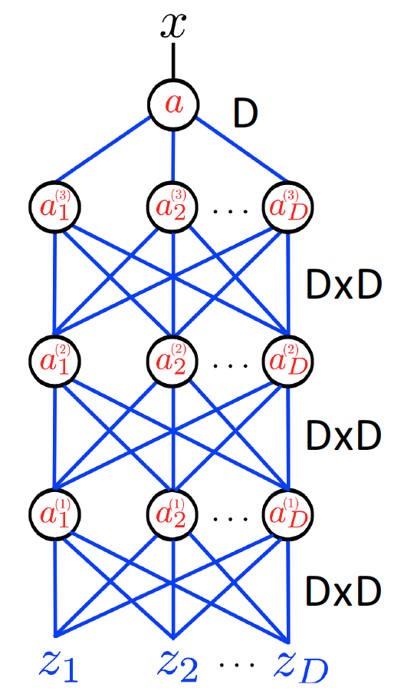
Very hard to train!
Number of parameters = 3 x (D x D) + D
To feed images to FCN, we can flatten the images.
For a 32x32 image, D=1024.
Number of parameters = 3 x (1024 x 1024) + 1024
~ 3x10⁶

Slide 10
Hierarchical Learning using Convolutional Neural Networks
Convolutional Neural Networks (CNNs) or Convnets are typically the go-to neural network architecture for computer vision tasks. CNNs consists of stacks of convolution, pooling layers, and fully connected layers. The convolution layers operate under the principle of convolution of two images. By defining a kernel which slides across an input, a convolution operation between the kernel and input can considerably reduce the number of parameters required for the model. By designing several convolutional layers in the CNN architecture, we can start to emulate hierarchical vision seen in mammalian vision.
Convolution layers are the feature extractors in the CNN. Each kernel or filter in the CNN layer shares parameters with the entire image input. The first few layers learns low-level features such as lines, edges. Layers later in the CNN learns the high-level features such as face, ear, etc. Fully connected networks convert the high-level features to output domain.

Slide 11
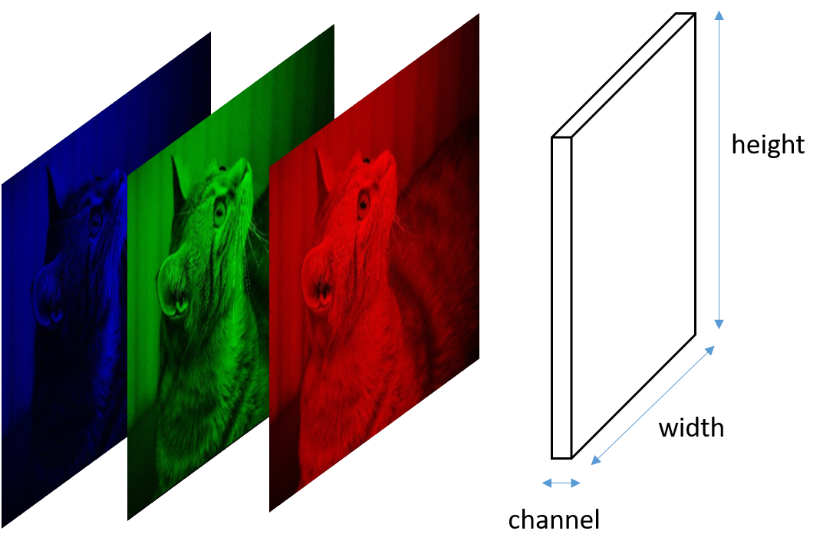
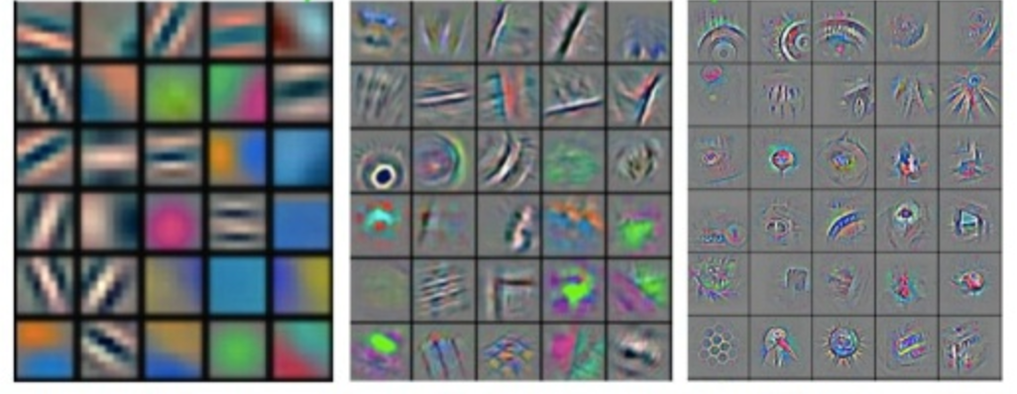

Conv Layer 1
Conv Layer 2
Conv Layer 3
CAT
Low-level features
Mid-level features
High-level features
https://www.analyticsvidhya.com/blog/2021/05/20-questions-to-test-your-skills-on-cnn-convolutional-neural-networks/

Slide 12
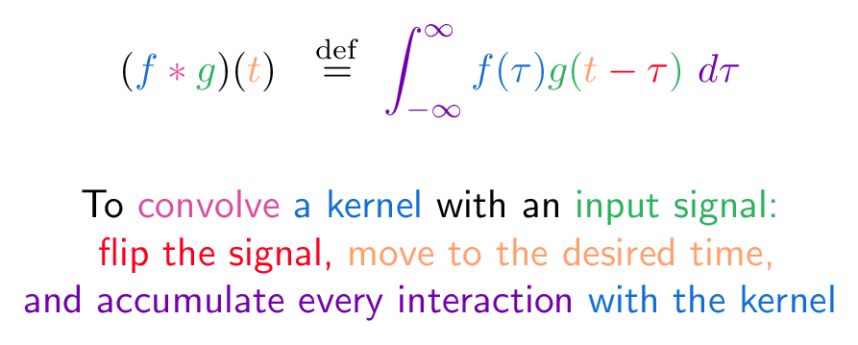
What is Convolution Operation?
Convolution operation expresses the amount of overlap of one function that is shifted over another function. In the domain of images, we can replace the integral with summation operation over the two dimensions (rows and columns), when one kernel is shifted over a source image.
https://betterexplained.com/articles/intuitive-convolution/

Slide 13
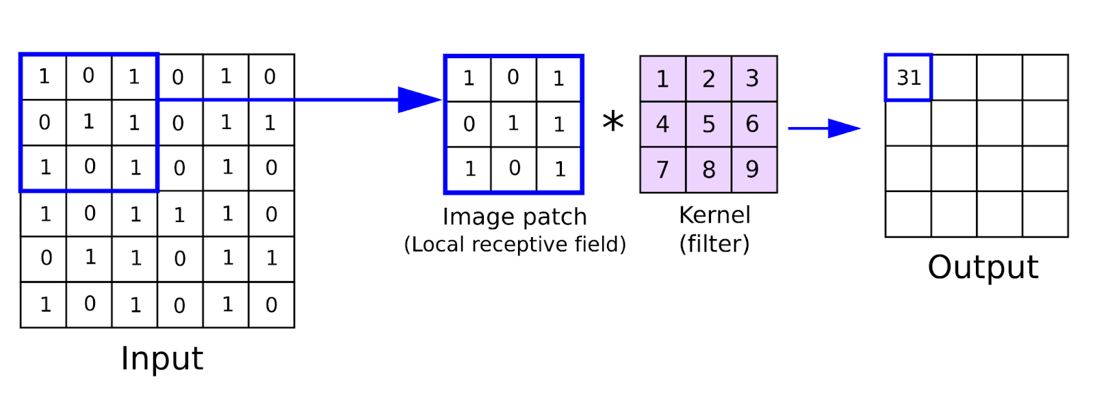

Convolution Operation for Images
An image patch is extracted, and a kernel is convolved with the image patch. Once the convolution operation is finished in the first patch, we shift the patch forward, and continue with the convolution operation. Resulting output are the convolved features, which gets passed as inputs to the next convolution layer. This allows for parameter sharing, where we don’t have to connect each input neuron from the previous layer to the next layer like we did for FCN. Now, we can learn good kernels to extract good information from an image patch.

Slide 14
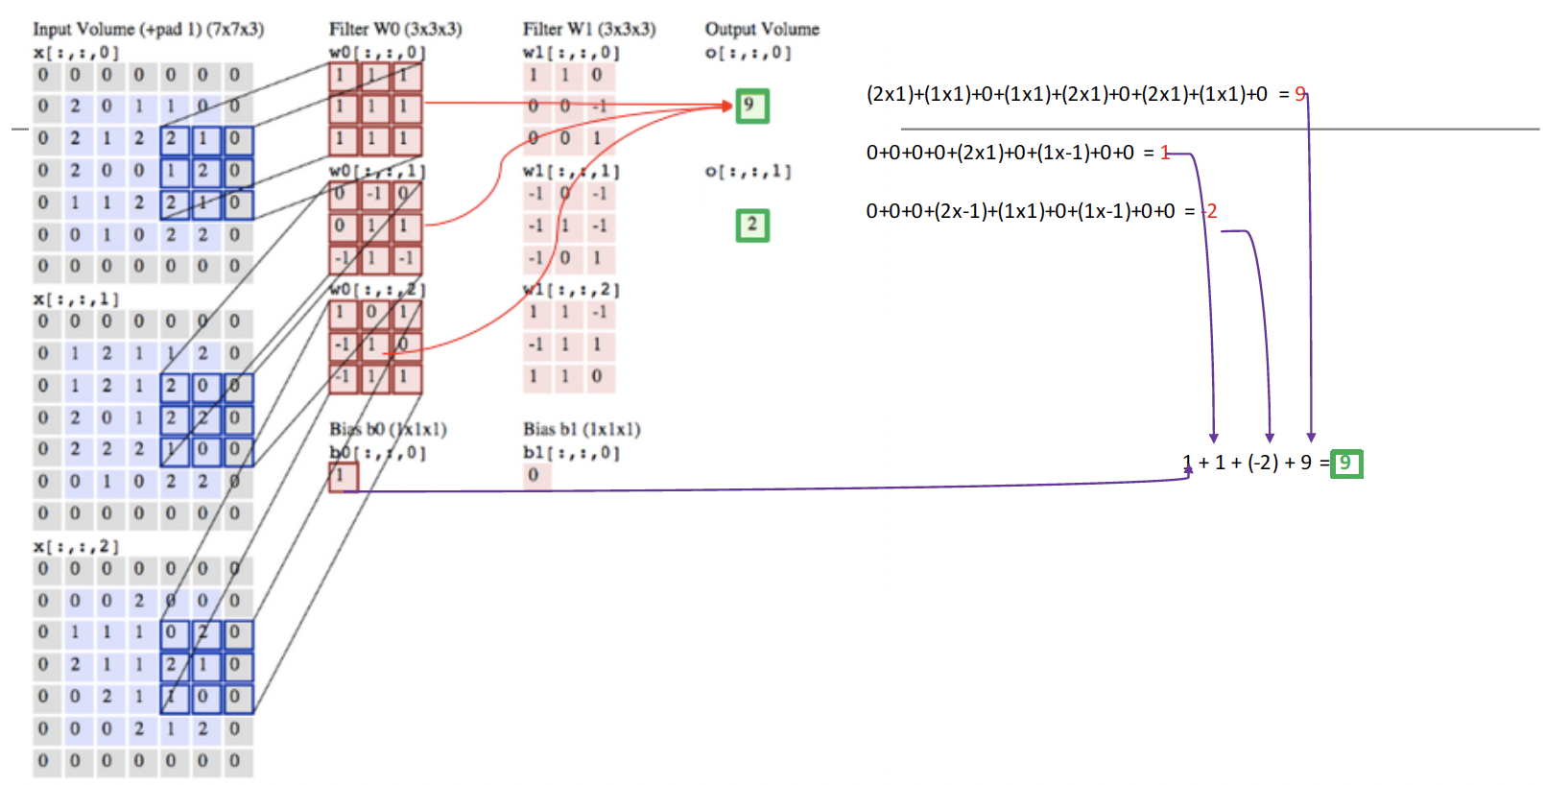

R
R
G
G
B
B
One channel each in kernel for each channel in the inputs
https://ml4a.github.io/demos/convolution/

Slide 15
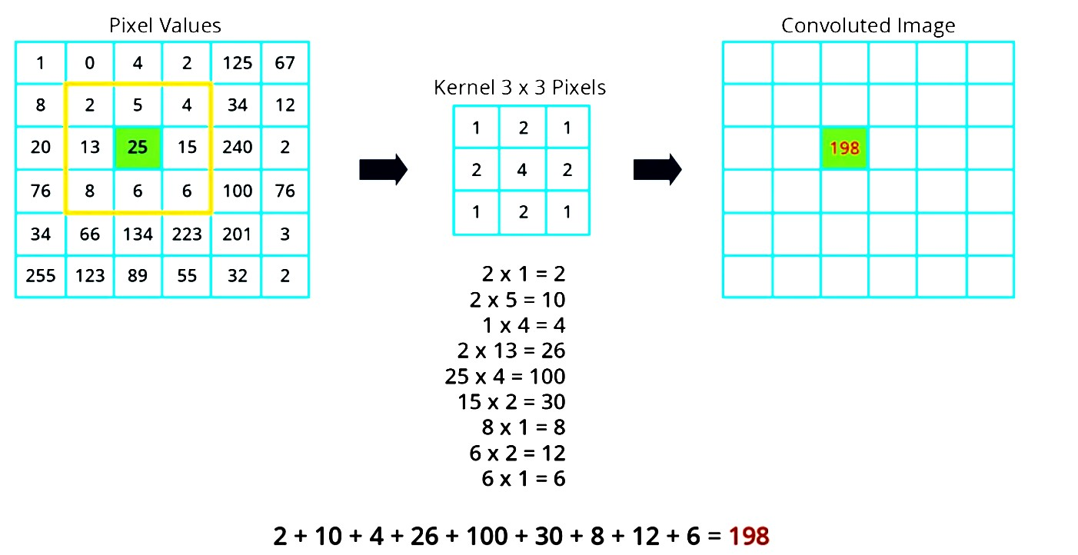
Another Example Calculation
The first image pixel value in this grid is two. So, we multiply that by the corresponding kernel value which is one in this case. So, 2 multiplied by 1 equals 2. We do the same with the second image pixel value in the grid. We can see that it has a value of 5. So, we multiply that by the corresponding kernel value which is 2 in this case. So, 5 multiplied by 2 equals 10. Now we do this for all the remaining pixel values inside our blue 3x3 grid.
Once we have the result of all of this operations, we sum all the numbers to get a total value of 198. So, 198 will be the corresponding value in our new convoluted image. And now, we can do the same with all the other pixel in our image.

Slide 16
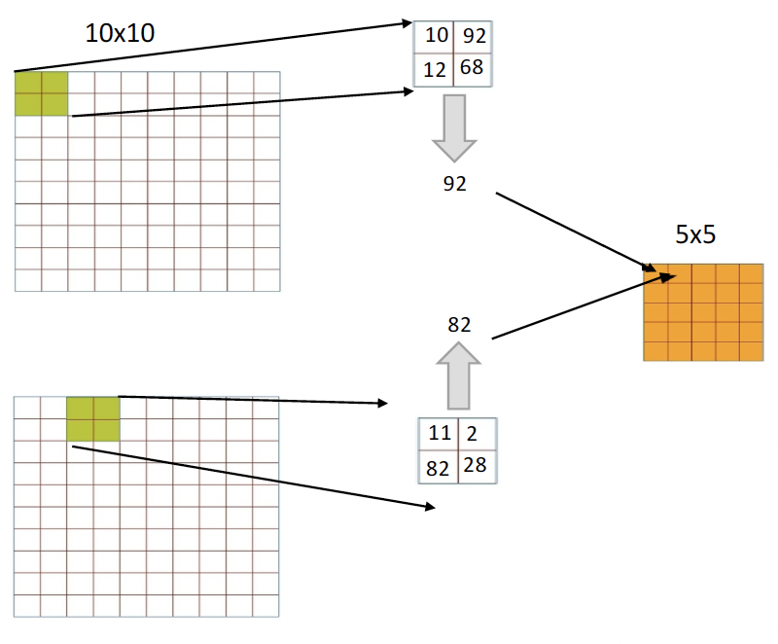
Pooling
Pooling operation reduces the dimensionality of each feature map by retaining the most important information present in them. There are different types of Pooling operation available, including Max Pooling, Average Pooling, etc. It is applied after convolution and RELU operations. By doing so, we reduce the size of the output feature maps considerably, thereby reducing the computational requirements for training the CNNs.
Example of Max Pooling.

Slide 17
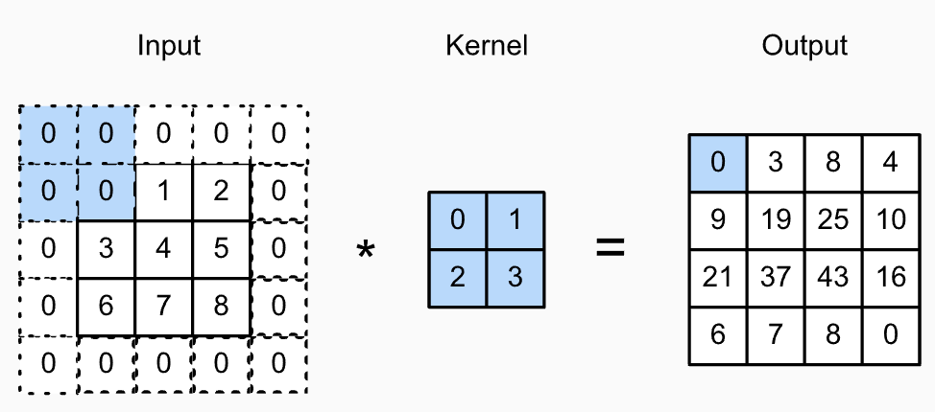
Padding
Convolution operation can fail to learn good information from the edges of the image. To extract more information from the periphery of the images, we can pad the image with zeros. This operation is called padding in DL. The example below illustrates an input image padded with 1-level of zeros. The kernel will now move convolve and move across the image, including the zeros, creating a different output map.
https://classic.d2l.ai/chapter_convolutional-neural-networks/padding-and-strides.html

Slide 18
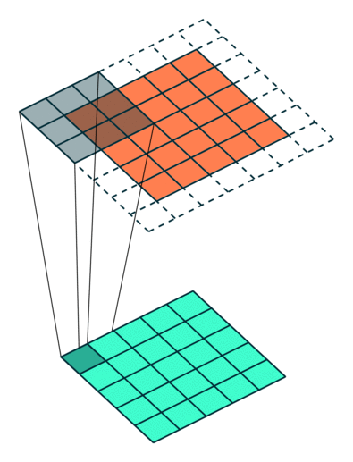

Strides
Stride is how much we move the kernels forward at each step during the convolution operation. When the stride is 1 then we move the filters one pixel at a time. When the stride is 2 then the filters jump 2 pixels at a time as we slide them around. This will produce smaller output volumes spatially.
Strides = 1
Strides = 2

